Slide 1

Customer Shopping Behavior Analysis
Uncovering insights from 3,900 purchases to guide strategic business decisions through data-driven analysis of spending patterns, customer segments, and product preferences.

Slide 2

DATASET OVERVIEW
The Foundation: Our Data
3,900
18
50
Total Purchases
Data Points
Locations
Transactions analyzed
Features per transaction
Geographic coverage
Key Features Captured
Customer demographics: Age, Gender, Location, Subscription Status
Purchase details: Item, Category, Amount, Season, Size, Color
Shopping behavior: Discounts, Promo Codes, Previous Purchases, Review Ratings, Shipping Type

Slide 3

Data Preparation & Cleaning
01
02
Data Loading & Exploration
Missing Data Handling
Imported dataset using pandas, examined structure with df.info() and summary statistics
Imputed 37 missing Review Rating values using median rating per product category
03
04
Feature Engineering
Database Integration
Created age_group bins and purchase_frequency_days columns for deeper analysis
Connected to PostgreSQL and loaded cleaned data for SQL analysis

Slide 4
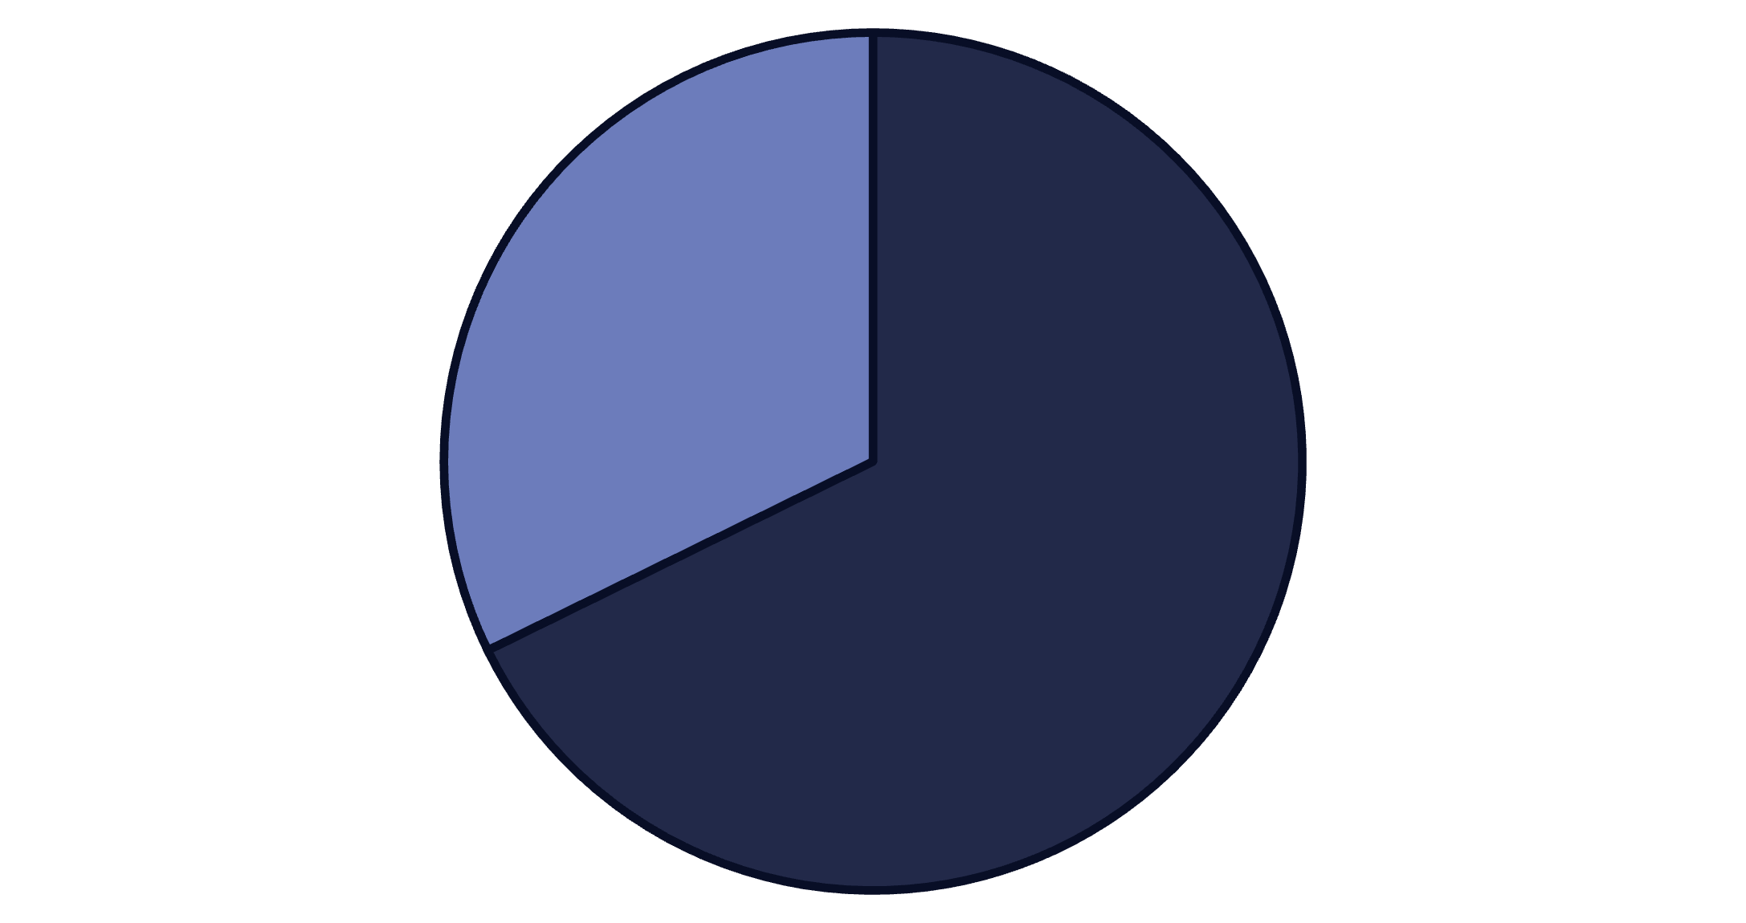
SQL ANALYSIS
Revenue Insights by Gender & Shipping
Key Findings
Male customers generate 68% of total revenue ($157,890 vs $75,191). Express shipping users spend $2 more on average ($60.48 vs $58.46) than standard shipping customers.
High-spending discount users identified: 839 customers used discounts but still spent above average purchase amount.
Male
Female

Slide 5





Top-Rated Products Drive Satisfaction
Gloves
Sandals
Boots
Hat
Highest rated at 3.86 average
Strong performance at 3.84
Customer favorite at 3.82
High satisfaction at 3.80
Skirt
Top five at 3.78 rating

Slide 6


Subscription Status Analysis
The Numbers Tell a Story
Only 27% of customers (1,053) have active subscriptions, while 73% (2,847) remain non-subscribers. Interestingly, non-subscribers generate higher total revenue ($170,436 vs $62,645) due to volume, though average spend is nearly identical ($59.87 vs $59.49).
Among repeat buyers with 5+ purchases, 958 are subscribers while 2,518 are not—revealing significant untapped subscription potential.
27%
73%
Subscribers
Non-Subscribers

Slide 7

Customer Segmentation Reveals Loyalty
Loyal Customers
Returning Shoppers
New Buyers
83 customers (2%) represent fresh acquisition opportunities
3,116 customers (80%) form the core base with consistent purchase history
701 customers (18%) show repeat behavior and growth potential

Slide 8
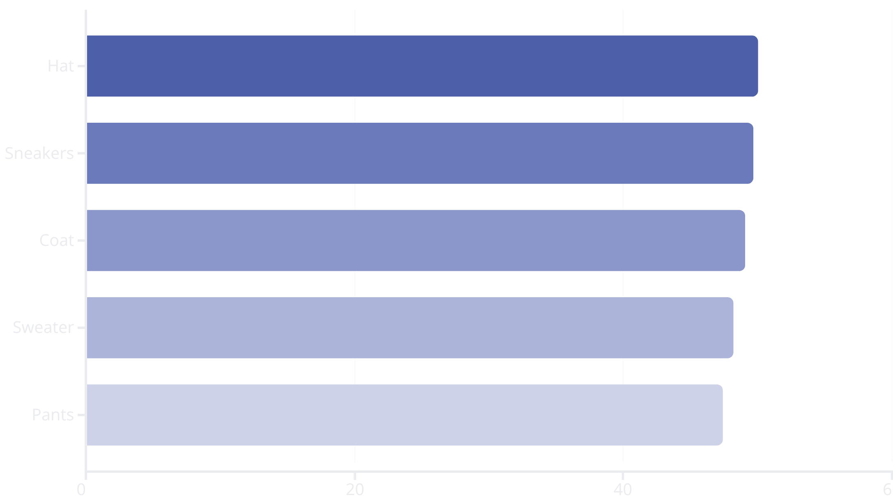
DISCOUNT STRATEGY
Discount-Dependent Products
Strategic Implications
Five products show discount rates near 50%, indicating heavy reliance on promotions. This presents an opportunity to balance sales volume with margin protection.
Consider testing price elasticity and repositioning these items to reduce discount dependency while maintaining customer interest.

Slide 9
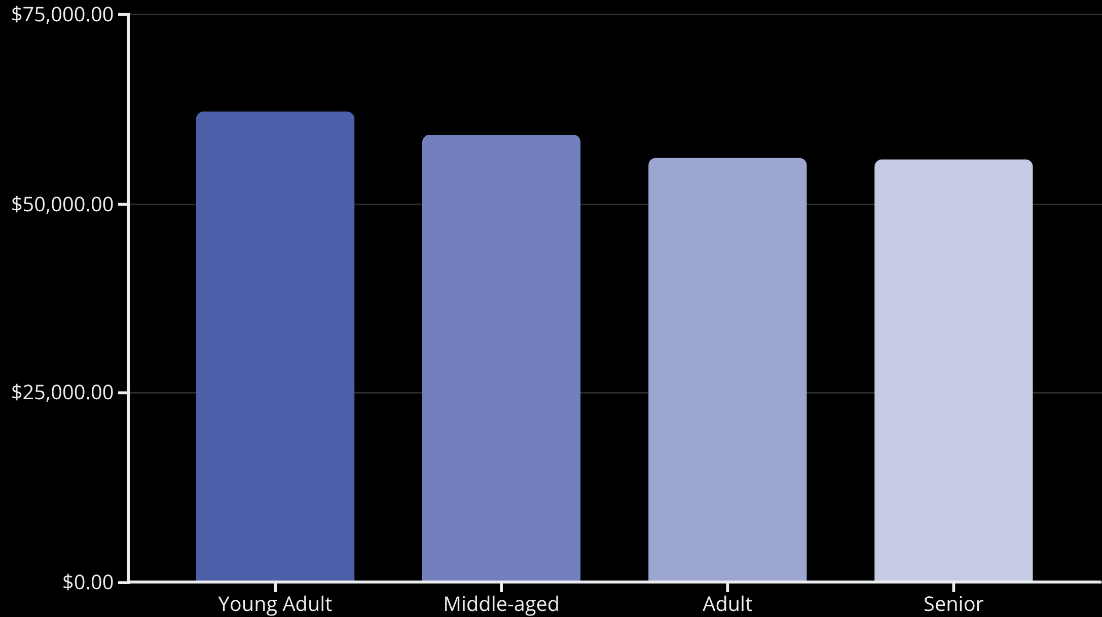
Revenue Performance by Age & Category
Category Leaders
Clothing dominates with 1,737 purchases across top items: Blouse, Pants, and Shirt.
Accessories follow led by Jewelry, Sunglasses, and Belt.
Footwear shows strength in Sandals, Shoes, and Sneakers.
Young Adults drive highest revenue at $62,143, making them prime targets for marketing campaigns.

Slide 10
ACTION PLAN
Strategic Recommendations
Boost Subscriptions
1
Promote exclusive benefits to convert the 2,518 repeat buyers who aren't yet subscribers
Customer Loyalty Programs
2
Reward repeat buyers to accelerate movement from Returning to Loyal segment
Review Discount Policy
3
Balance promotional sales with margin control for discount-dependent products
Product Positioning
4
Highlight top-rated items (Gloves, Sandals, Boots) in marketing campaigns
Targeted Marketing
5
Focus on Young Adults and express-shipping users for maximum revenue impact

